Slide 1
Tree of Thoughts: Deliberate Problem Solving with Large Language Model
Borg Lab
斑實驗室
Team 2

Slide 2
Abstract
🔹 Problem with Current LMs
Limited to token-level, left-to-right decisions.
Struggle with exploration, strategic planning, and lookahead.
🔹 Introducing Tree of Thoughts (ToT)
Expands on Chain of Thought (CoT).
Uses structured reasoning paths ("thoughts").
Allows self-evaluation, exploration, and backtracking.
🔹 Impact
Improves problem-solving for complex tasks.
Moves AI closer to strategic reasoning.
Notes:
problems new method

Slide 3
Introduction
🔹 Evolution of Language Models (LMs)
Originally designed for text generation (e.g., GPT, PaLM).
Now can handle tasks involving mathematical, symbolic, commonsense, and knowledge reasoning.
🔹 Challenge: Autoregressive Mechanism
LMs generate text token-by-token, in a left-to-right manner.
Limitations:No strategic planning.Struggles with problems requiring exploration, lookahead, or backtracking.
🔹 Key Questions
Can such a simple mechanism evolve into a general problem solver?
What alternative mechanisms could improve its reasoning and planning abilities?
Notes:
for human : system 1&2

Slide 4
Background
Existing Problem-Solving Methods in Language Models
Language models (LMs) typically solve problems through Input-Output (IO) prompting.
🔹 Definitions:
pθ: A pre-trained language model with parameters θ.
x, y, z, s (lowercase letters): Language sequences, e.g., x = (x[1], …, x[n]), where each x[i] is a token.
S (uppercase letters): A collection of language sequences.
🔹 IO Prompting (Input-Output Prompting):
Generates output y using pθ(y | promptIO(x)).
promptIO(x) formats input x with task instructions and/or few-shot examples.
Notes:
method we already have. most common

Slide 5

Background : Chain-of-Thought (CoT) Prompting
CoT Prompting was introduced to handle cases where the mapping from input x to output y is non-trivial (e.g., solving a math problem). 🔹 Key Idea:
Introduces a chain of thoughts (z1, z2, ..., zn) as intermediate reasoning steps between x and y.
Each zi is a coherent language sequence that contributes to solving the problem (e.g., an intermediate equation in a math QA task). 🔹 Process:
Thoughts are generated sequentially:
Final output is then produced:
In practice, the full sequence [z1, ..., zn, y] is sampled continuously, leaving ambiguity in how thoughts are structured (e.g., as phrases, sentences, or paragraphs).
Notes:
each thought is generated by the original input and previous thoughts

Slide 6


Self-Consistency with Chain-of-Thought (CoT-SC)
CoT-SC (Self-Consistency with CoT) is an ensemble approach that improves CoT by exploring diverse reasoning paths. 🔹 Key Features: Generates k independent chains of thought :
Selects the most frequent output as the final answer:
🔹 Advantages:
Explores diverse solutions, improving accuracy.
More reliable than a single CoT sequence due to broader coverage of possible solutions. 🔹 Limitations:
Fixed reasoning paths with no local adjustments.
Works well for limited-output tasks (e.g., multiple-choice) but struggles with open-ended problems.
Notes:
Generates k independent chains of thought (each with potentially different reasoning steps)

Slide 7
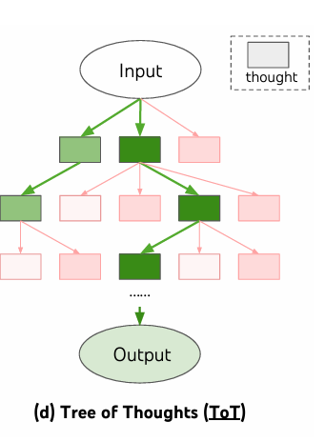
Tree of Thoughts: Deliberate Problem Solving with LM
combinatorial problem space
tree where the nodes represent partial solutions
branches correspond to operators that modify them
Which branch to take?
Heuristics
navigate the problem-space and guide the problem-solver towards a solution.
Notes:
Combinatorial( 組合的 )

Slide 8

Deliberate Problem Solving with LM
two key shortcomings
Locally -> do not explore other branches of the tree(different thought process )
Globally -> do not incorporate any type of planning, lookahead, or backtracking
Tree of Thoughts (ToT) -> solving way
ToT frames any problem as a search over a tree, where each node is a state s
ToT involves answering four questions
How to decompose the intermediate process into thought steps
How to generate potential thoughts from each state
How to heuristically evaluate states
What search algorithm to use
Notes:
perspective highlights two key shortcomings of existing approaches that use LMs to solve general problems:
a partial solution with the input and the sequence of thoughts so far.

Slide 9
Deliberate Problem Solving with LM
Thought decomposition(思維分解)
ToT leverages problem properties to design and decompose intermediate thought steps
depending on different problems, a thought could be different.
thought should be …
“small” enough so that LMs can generate promising and diverse samples
“big” enough so that LMs can evaluate its prospect toward problem solving
Notes:
generating a whole book is usually too “big” to be coherent

Slide 10
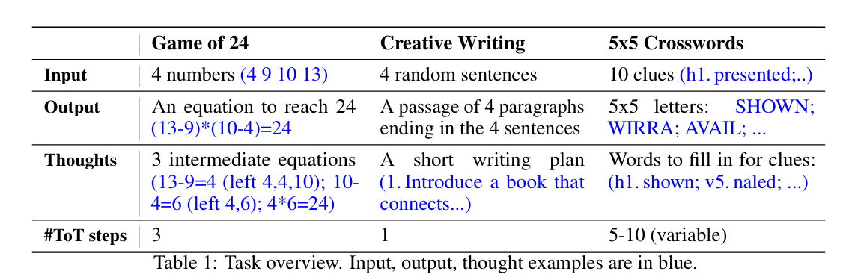
Deliberate Problem Solving with LM
Thought decomposition(思維分解)

Slide 11

Deliberate Problem Solving with LM
Thought generator(思維生成器)
Given a tree state s, we have two strategies to generate k candidates for the next thought step:
Sample i.i.d.thoughts from a CoT prompt (從 CoT 提示隨機抽樣)
when the thought space is rich -> samples lead to diversity
Propose thoughts sequentially using a “propose prompt”(順序提出思維)
when the thought space is more constrained -> proposing different thoughts in the same context avoids duplication

Slide 12
Deliberate Problem Solving with LM
State evaluator(狀態評估器)
using the LM to deliberately reason about states.
such a deliberate heuristic can be more flexible than programmed rules, and more sample-efficient than learned models
two strategies to evaluate states either independently or together:
Value each state independently(獨立評估每個狀態的價值)
value prompt
Generate:
a scalar value v -> 1~10
Classification -> sure/likely/impossible
evaluation via lookahead simulations(前瞻模擬) and commonsense
do not need to be perfect, and only need to be approximately helpful
Notes:
5, 5, 14 can reach 24 via 5 + 5 + 14
1 2 3 are too small to reach 24

Slide 13
Deliberate Problem Solving with LM
two strategies to evaluate states either independently or together:
Vote across states(跨狀態投票)
voted out based on deliberately comparing different states in S in a vote prompt.
Situation : harder to directly value (e.g. passage coherency(連貫性))
“which state to explore” as a multi-choice QA, and use LM samples to vote for it

Slide 14
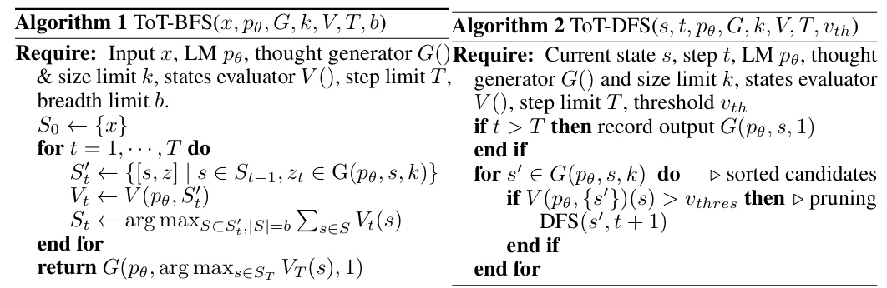
Deliberate Problem Solving with LM

Slide 15
Deliberate Problem Solving with LM
Search algorithm
Breadth-first search (BFS) (Algorithm 1)(廣度優先搜索)
maintains a set of the b most promising states per step
tree depth is limit (T ≤3)
initial thought steps can be evaluated and pruned to a small set (b ≤ 5)
Depth-first search (DFS) (Algorithm 2)(深度優先搜索)
explores the most promising state first
Until…
final output is reached
impossible to solve the problem from the current s
Notes:
In both cases, DFS backtracks to the parent state of s to continue exploration.

Slide 16
Deliberate Problem Solving with LM
ToT has several benefits as a method for general problem-solving with LMs
Generality
Modularity
Adaptability
Convenience

Slide 17
Overview of Experiments
Introduce that the paper validates the Tree of Thoughts (ToT) framework on three tasks:
Game of 24: A numerical reasoning challenge.
Creative Writing: Generating a coherent passage that ends with given sentences.
Mini Crosswords: (or another task that highlights planning and local search).
Emphasize that these experiments demonstrate how ToT can overcome the limitations of traditional IO, Chain of Thought (CoT), and CoT-Self-Consistency methods.

Slide 18
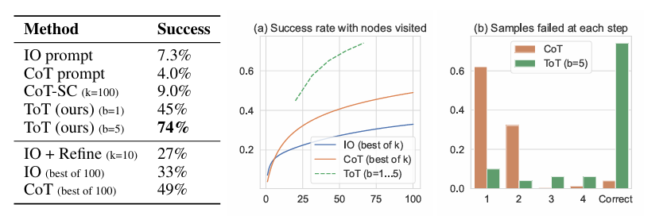
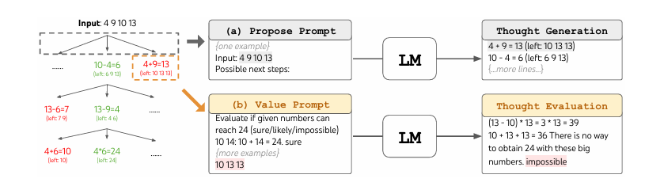
Game of 24 Experiment
Task Description: Given 4 numbers and basic arithmetic operators, the goal is to form an equation that equals 24.
Challenges: Traditional IO, CoT, and CoT-SC methods achieve only 4%-9% success rates.
Experimental Design:
Use a dataset from 4nums.com (selecting the harder games, e.g., indices 901-1000).
Decompose the problem into 3 thought steps, with each step generating candidate intermediate equations.
Use a Breadth-First Search (BFS) strategy, keeping the top candidates (e.g., breadth b=5) at each step.
Key Results:
IO, CoT, and CoT-SC achieved around 7.3%, 4.0%, and 9.0% success respectively.
With ToT and BFS (b=5), the success rate reached up to 74%.

Slide 19
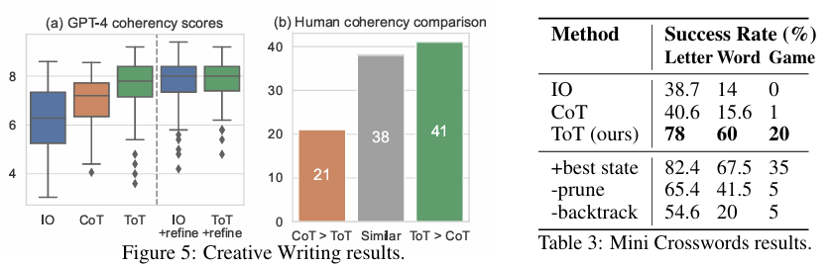
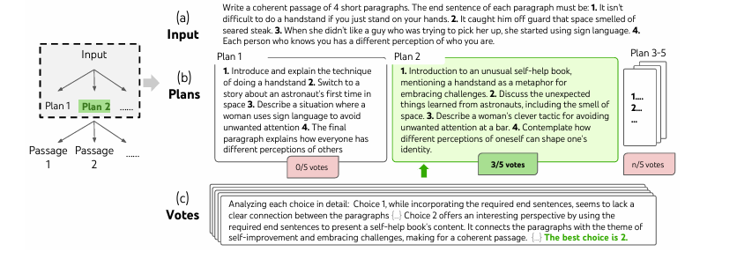
Creative Writing Task
Task Description: Given 4 random sentences, generate a coherent passage where each of the 4 paragraphs ends with one of the input sentences.
Challenges: The task is open-ended with no fixed “correct” answer; it tests not only constraint adherence but also overall coherence and style.
Experimental Design:
Use zero-shot prompting with GPT-4 to generate passages.
Evaluate the outputs using two methods: automatic scoring (GPT-4 providing a 1–10 score) and human blind comparisons.
For ToT, first generate several writing plans and then create passages based on the best plan, using voting to select the final output.
Key Results:
Average GPT-4 scores: ToT passages scored about 7.56, compared to IO (6.19) and CoT (6.93).
In human evaluations, ToT was preferred in a significant proportion of pairwise comparisons (e.g., a 41:21 win ratio).

Slide 20
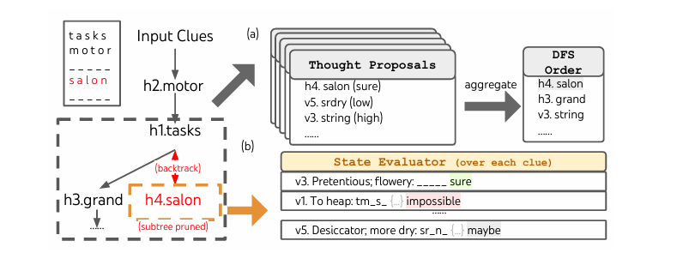
Mini Crosswords Task & Summary
Mini Crosswords Task: (Briefly describe the task if it is included—highlight that it involves both local and global planning.)
Overall Benefits of ToT:
Strategic Exploration: Multiple reasoning paths allow the model to escape the limitations of left-to-right generation.
Modularity and Flexibility: The framework can be tailored to different tasks by adjusting thought decomposition, candidate generation, and search strategies.
Substantial Improvement: ToT shows significant performance gains over traditional methods across multiple tasks.

Slide 21
RELATED WORK

Slide 22
Evolution of Problem Solving in LMs
ToT framework draws from historical AI and cognitive science.
Integration of classical theories with modern techniques to enhance LMs.

Slide 23
Integration of Multiple Plans
Dynamic Problem-Solving Approach
Enable exploration of multiple plans at each decision point
Represents a significant advancement over traditional method

Slide 24
Self-Evaluation Mechanisms
Novel Decision-Making Process
Assess outputs internally rather than relying on external rewards.
Promote iterative refinement in problem-solving effectiveness.

Slide 25
Advancements Over Existing Methods
Limitations of Traditional Approaches
Traditional methods often depend on symbolic guidance or external inputs.
ToT's thought tree structure enhances flexibility and effectiveness.

Slide 26
Exploration of Complex Tasks
Limitations of Traditional Approaches
Traditional methods often depend on symbolic guidance or external inputs.
ToT's thought tree structure enhances flexibility and effectiveness.

Slide 27
Potential Impact on Real-World Applications
Transformative Capabilities
Systematic exploration and evaluation could revolutionize creativity and nuanced decision-making.
Emphasizes synergy between traditional AI strategies and language modeling.

Slide 28
Challenges and Trade-offs
ToT may require more computational resources than traditional methods.
Modular design helps balance performance and cost for diverse tasks.

Slide 29
Future Research Directions
Focus on Advanced Strategies
Need for exploration into planning and decision-making enhancements.
Aim to improve performance on complex, unformalizable tasks.

Slide 30
Conclusion
Broader Capabilities of Language Models
Significantly enhance LMs' complex problem-solving abilities.
Represents a promising direction, merging classical and modern methodologies.

